Slide 1
Predicting User Score using Random Forest Methods
Dillon Dugan

Slide 2
The Data Sources
For this project, 3 main datasets were merged together in order to be used with the random forest methods.
The first dataset is a complete set of game information directly from Steam databases uploaded to GitHub
Steam is a video game distribution service, offering tens of thousands of games digitally
This includes the name, price, release date, number of owners, developer and publisher, average playtime, and metascore of the game
The next database includes the percentage of positive reviews for each game in the Steam database uploaded to Kaggle
The last one contains public user scores of games (from a different source than Steam) compared to metascores for games released from 2000 to late-2018 uploaded to Kaggle

Slide 3
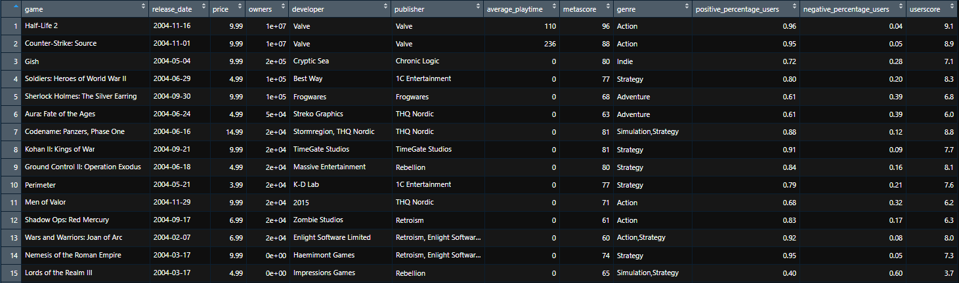
The Final Dataset
The final dataset will have all the variables included in the 3 collected datasets, minus any duplicate variables or rows with NA values. This ended up being 1150 rows with 11 variables
The most important being the user score associated with each game obtained from the third Metacritic dataset. This will be used as the outcome variable for the regression model and to test the accuracy of the random forest predictions

Slide 4

Research Question
Can User Scores be accurately predicted based of a number of variables using Random Forest Methods?
Given a dataset with X amount of variables that contribute to a games perception, we are testing Random Forest using those variables to accurately predict the user score for certain video games
Random forest methods will take a certain number of given trees and make decisions based on a smaller subset of variables at each branch to make predictive values
Additionally, which variables were the most important for decision trees in the Random Forest Model

Slide 5
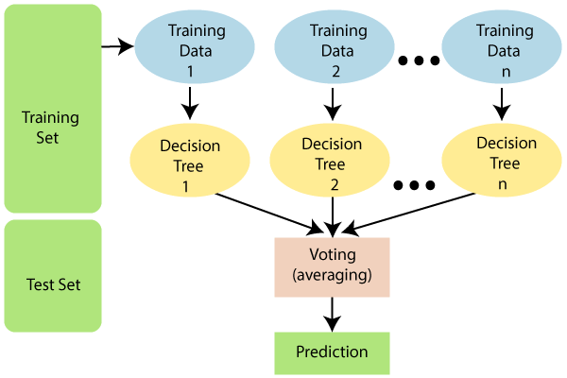
Random Forest Modeling
Random forest modeling uses many decision trees and bootstrap aggregating (bagging) to create multiple combinations of the model over multiple trees to reduce variability and overfitting, thus increasing the predictive power of the final model
The bagging function of random forest methods creates a natural cross-validation process by containing roughly 2/3 of the input data. The remaining 1/3 is left out and is known as out-of-bag (OOB) sample.
The OOB observations can be used to estimate the model’s accuracy

Slide 6
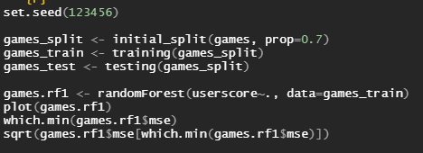
randomForest Method
randomForest from the randomForest package performs a very basic implementation of random forest modeling by taking formula for modeling and a dataset to predict values for the outcome variable of the formula
Due to the performance of the function, it requires very little tuning and doesn’t require any processing before being applied
Though the function has many options, only two require possible tuning. The function performs with defaulted ntree=500 and mtry=floor(# of explanatory variables)/3 for regression and sqrt(# of explanatory variables) for classification
Split the games data into 70% training/30% testing
No need for a validation set as randomForest uses OOB as a natural cross-validation

Slide 7
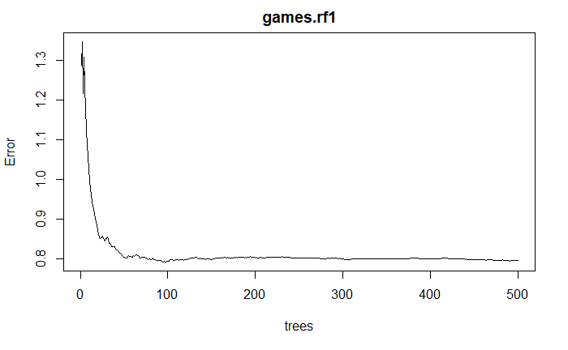

randomForest Method plot
This plot demonstrates the error rate as the number of trees are increased
Error rate stabilizes at about 50 but continues to decrease
Anything above 100 trees was redundant in this case
Best MSE tree num
RMSE value

Slide 8
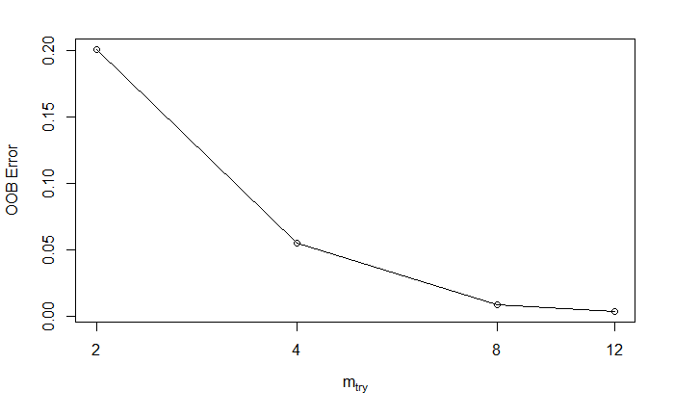
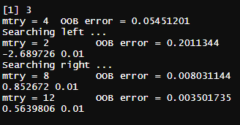
randomForest Tuning
This plot demonstrates the OOB error rate as the mtry increases
This graph tries different mtry until the OBB error stops improving by 1% for tuning of the mtry parameter
Even though the best mtry should be features/3 = 3, the model seemed to have less OOB error as mtry increased

Slide 9
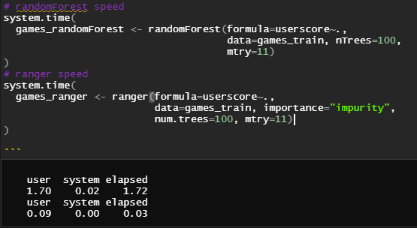
ranger Method
ranger is a function included in the randomForest package that performs acceptably faster than the basic randomForest function.
This is very helpful with very large datasets
The ranger function is a faster implementation because it implements Breiman’s random forest method from C++, which processes bagging at a quicker pace
Breiman’s implementation generates new training sets based on the output of the original training set rather than selecting new training sets based on a random set of weights

Slide 10
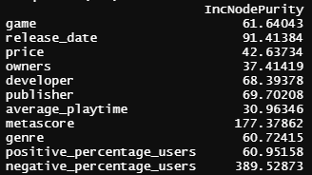
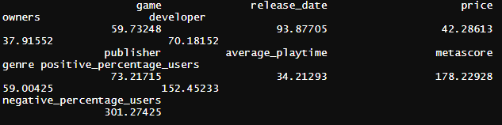
Modeling Analysis
Comparing both the randomForest and ranger method, the predicted user score for each game seems close to the actual user score. However, the OOB observations give randomForest a MSE value of 0.817 and ranger a MSE value of 0.829
Considering the data, these values mean that randomForest and ranger both can predict the user score accurately. However, it would be nice to have the values a little lower, possibly with more explanatory variables
Taking a look at the importance of both models, it seems Price, Number of Owners, and Average Playtime of the game were the most critical variables for both models
randomForest importance
ranger importance

Slide 11
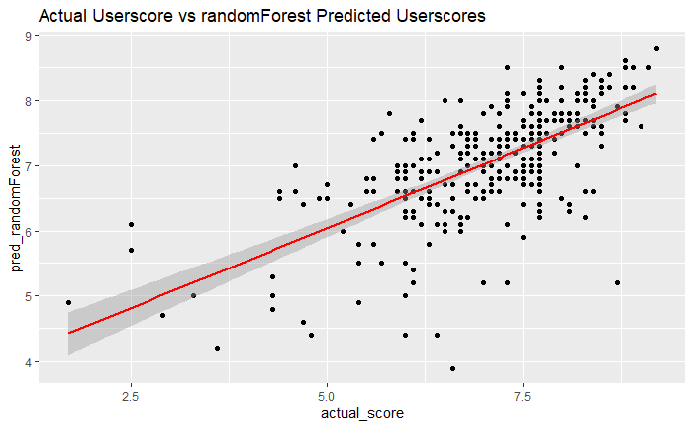
Actual vs randomForest predicted Userscores
There is a clear positive relation however the data is scattered and points aren’t exactly 1:1

Slide 12
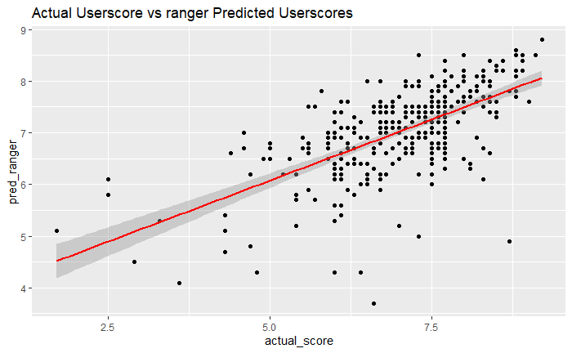
Actual vs ranger predicted Userscores
Same as before, there’s a clear positive relation however the data is scattered and points aren’t exactly 1:1

Slide 13
Sources
https://towardsdatascience.com/analyzing-video-games-data-in-r-1afad7122aab
https://raw.githubusercontent.com/rfordatascience/tidytuesday/master/data/2019/2019-07-30/video_games.csv
https://www.kaggle.com/trolukovich/steam-games-complete-dataset
https://www.kaggle.com/skateddu/metacritic-games-stats-20112019
https://towardsdatascience.com/random-forest-explained-7eae084f3ebe
https://uc-r.github.io/random_forests
http://uc-r.github.io/regression_trees#bag
https://miamioh.instructure.com/courses/38953/pages/random-forest
https://www.stat.berkeley.edu/~breiman/randomforest2001.pdf

Slide 14
Questions?

